Slide 1

NeRF 실습
Presenter: 형준하
Notes:
코드 실습 수업
시간 단축
Nerf 논문과 코드 괴리, 코드 복잡

Slide 2


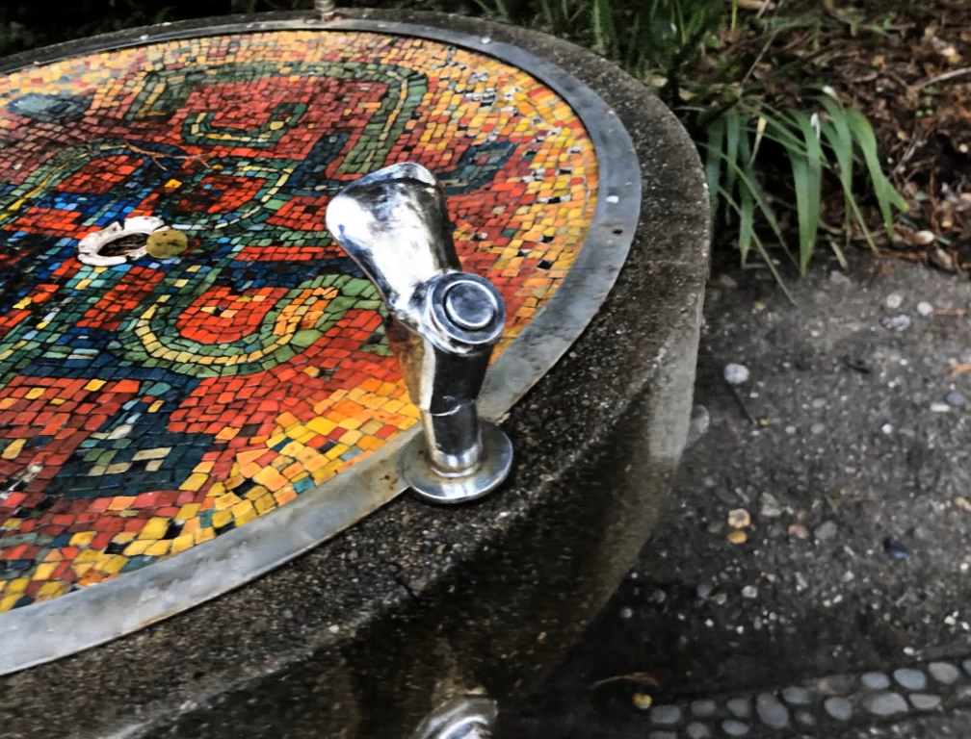

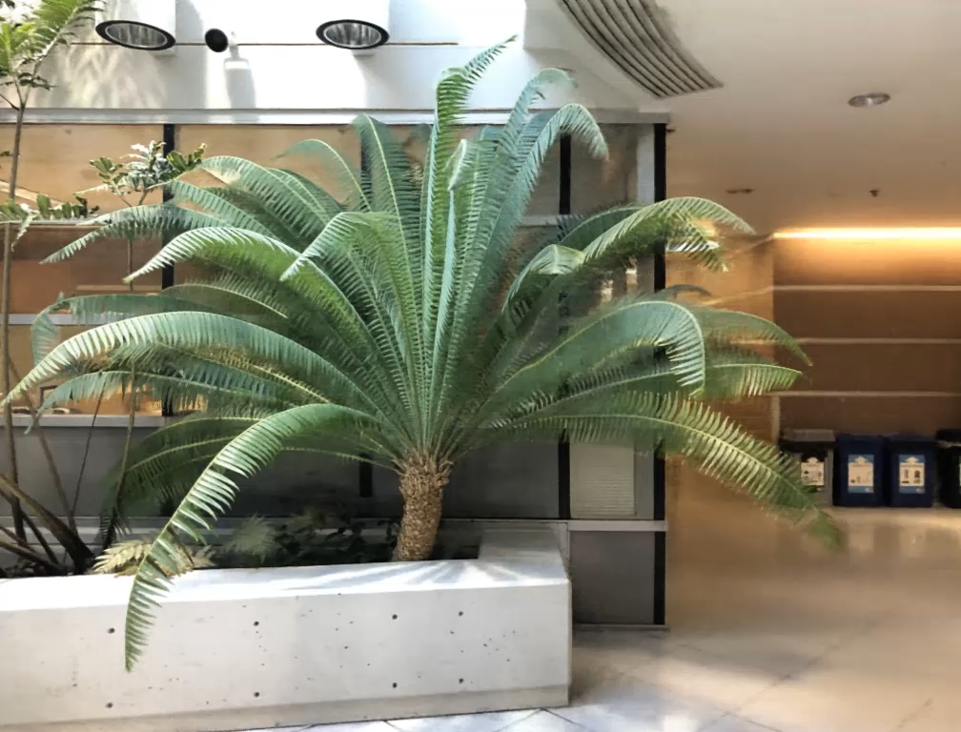
NeRF
Representing Scenes as Neural Radiance Fields for View Synthesis
ECCV 2020 Oral – Best Paper Honorable Mention

Slide 3
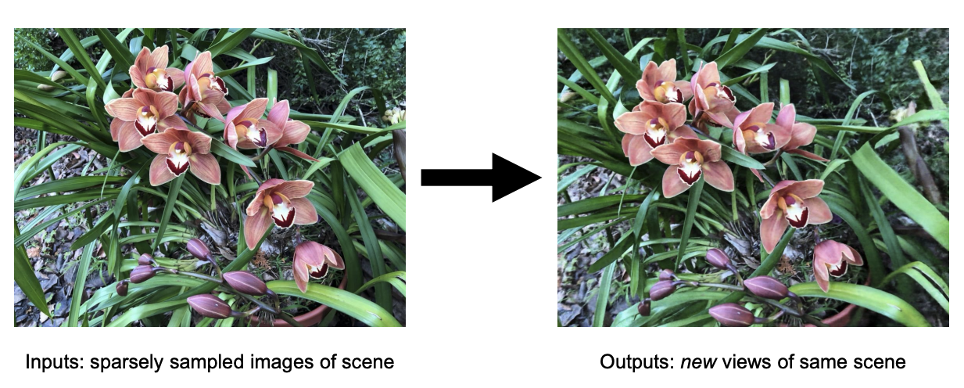
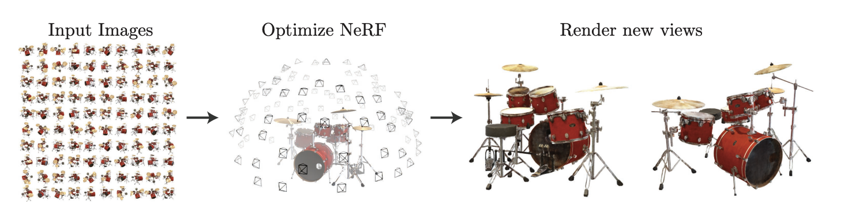
Introduction
Task : Novel View Synthesis(NVS) or View Interpolation
Mildenhall et al, “NeRF: Representing Scenes as Neural Radiance Fields for View Synthesis”, ECCV 2020
Notes:
이런거다
근데 어렵다!

Slide 4
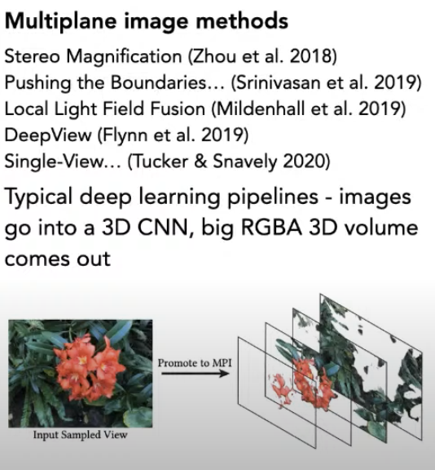
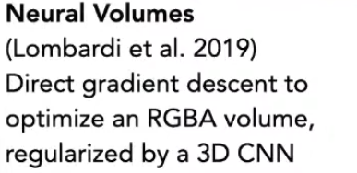
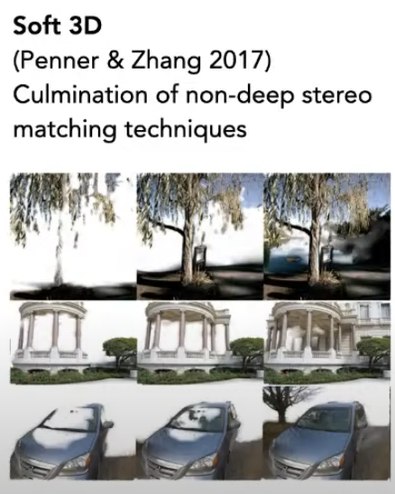
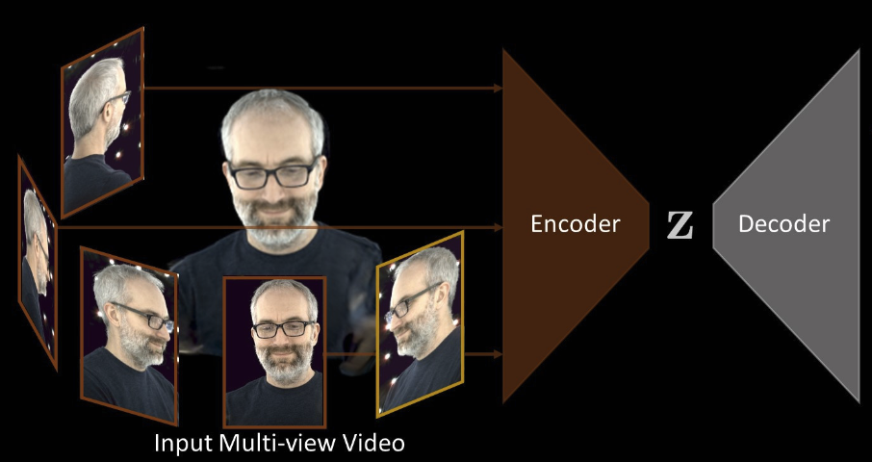
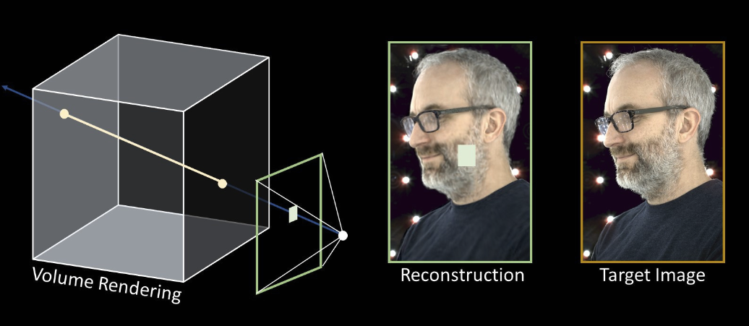
Introduction
RGB-alpha volume rendering for view synthesis
1~10GB storage consumption ..!
Figures borrowed from John Barron’s slides

Slide 5
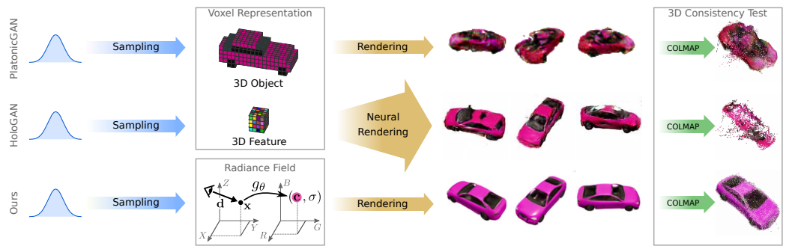
Introduction
Voxel representations
leads to discretization artifacts or degrades view-consistency
Large memory consumption!
Implicit Representation has the advantages as follows:
Lighter than voxel representation
Continuous
Neural Radiance Field encodes a continuous volume within the deep neural network, whose input is a single 5D coordinate and whose output is the volume density and view-dependent RGB color.
Voxel Representation
Implicit Representation
Neural Radiance Field
Mildenhall et al, “NeRF: Representing Scenes as Neural Radiance Fields for View Synthesis”, ECCV 2020

Slide 6
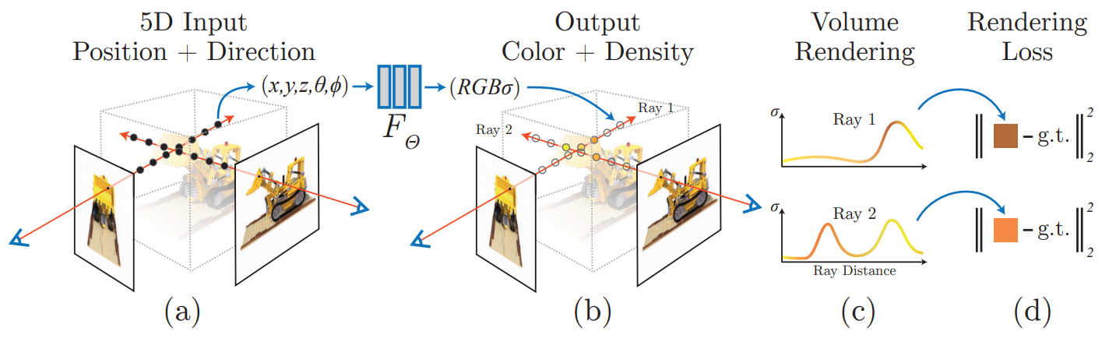
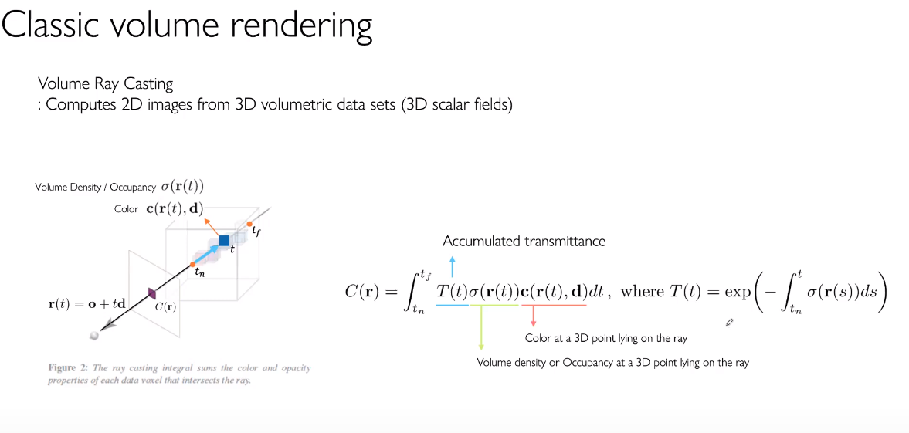
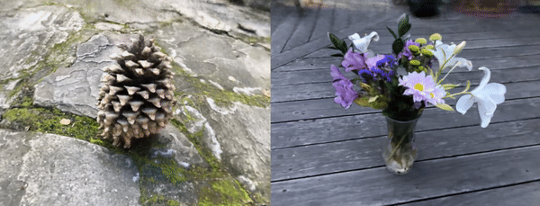
NeRF: Representing Scenes as Neural Radiance Fields for View Synthesis
The paper proposes a method that synthesizes novel view of complex scenes by optimizing an underlying continuous volumetric scene function using a sparse set of input views.
This algorithm represents a scene using a fully-connected deep network, whose input is a single 5D coordinate and whose output is the volume density and view-dependent RGB color at that spatial location.
Classical volume rendering techniques are used to accumulate those colors and densities into a 2D image.
Mildenhall et al, “NeRF: Representing Scenes as Neural Radiance Fields for View Synthesis”, ECCV 2020

Slide 7
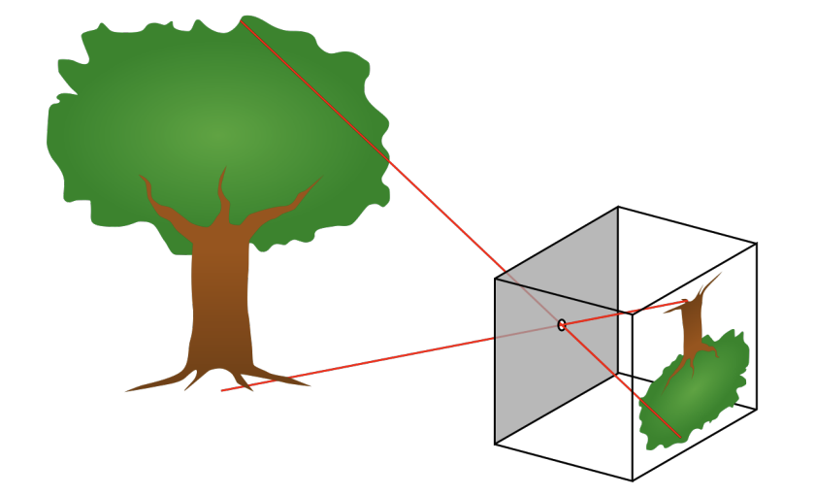
Pinhole Camera Model
Pinhole camera model

Slide 8
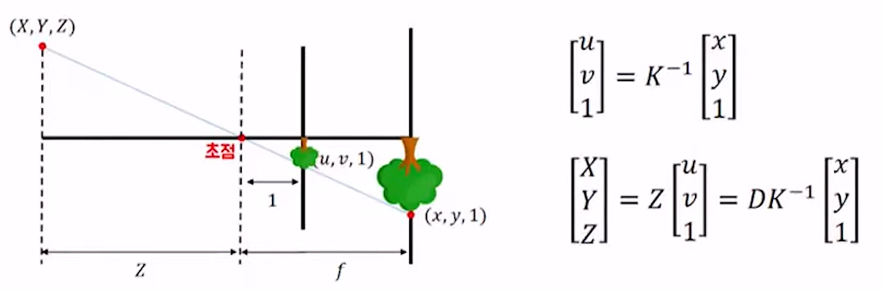
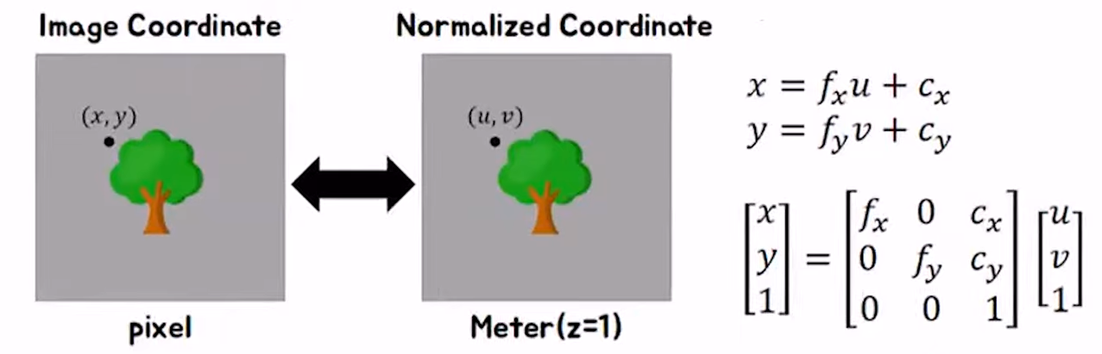
Camera Intrinsic and Extrinsic Parameters
Image Plane
Normalized Plane

Slide 9
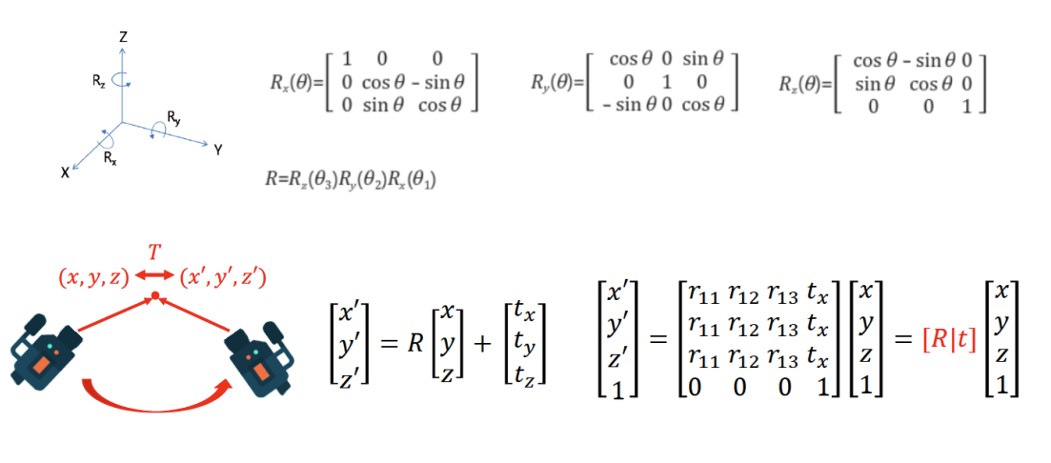
Camera Intrinsic and Extrinsic Parameters
Extrinsic Parameters

Slide 10
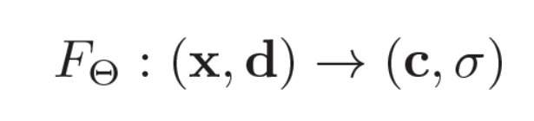
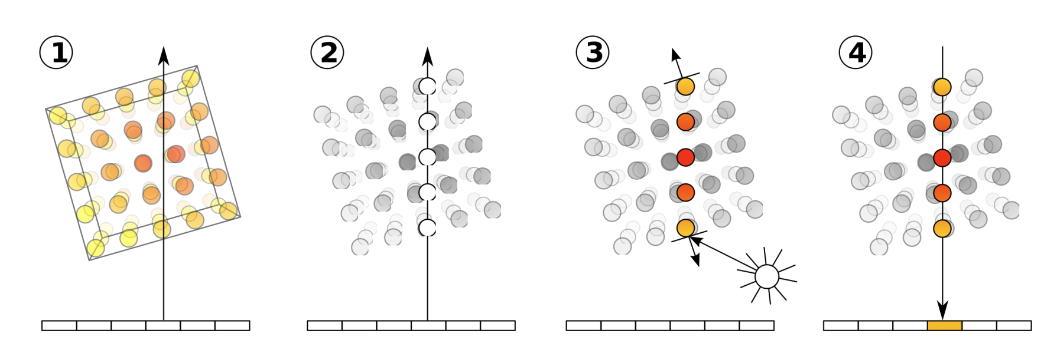
Method
Neural Radiance Fields
Mildenhall et al, “NeRF: Representing Scenes as Neural Radiance Fields for View Synthesis”, ECCV 2020

Slide 11
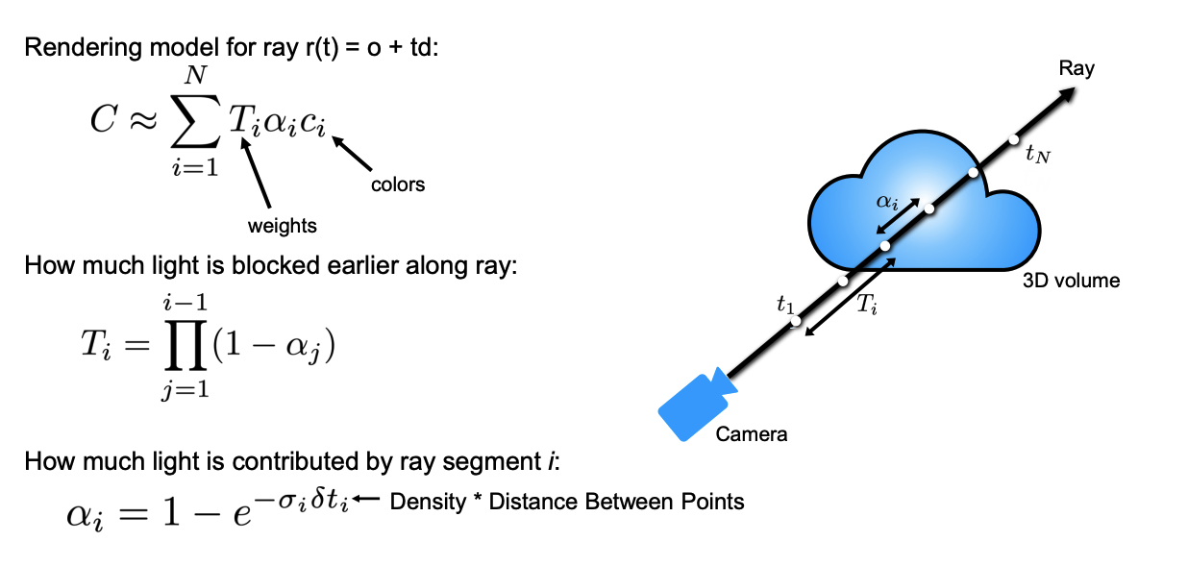
Method
Volume rendering is trivially differentiable
Mildenhall et al, “NeRF: Representing Scenes as Neural Radiance Fields for View Synthesis”, ECCV 2020

Slide 12
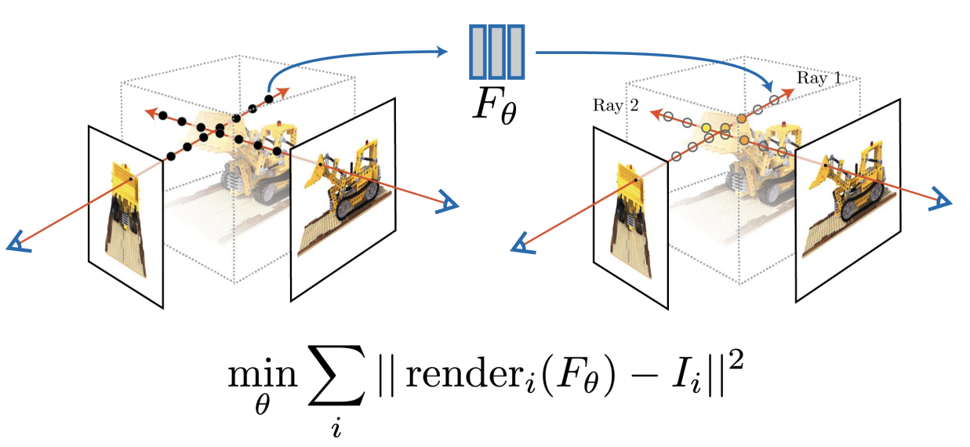
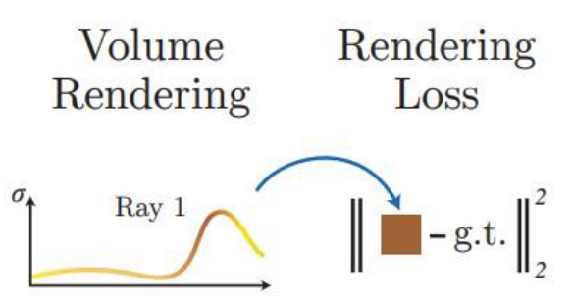
Method
Optimize with gradient descent on rendering loss
Mildenhall et al, “NeRF: Representing Scenes as Neural Radiance Fields for View Synthesis”, ECCV 2020

Slide 13
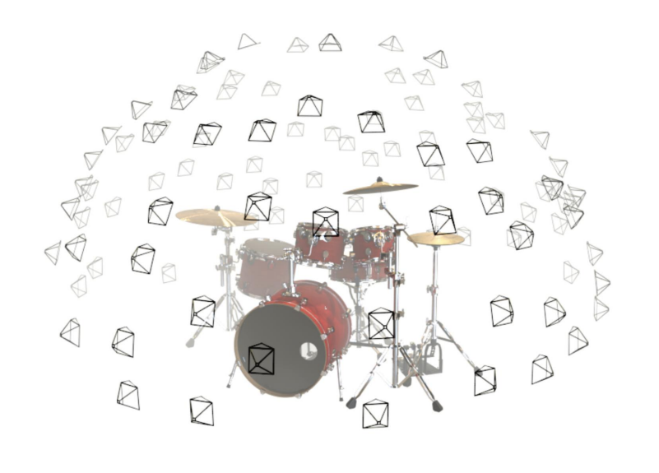
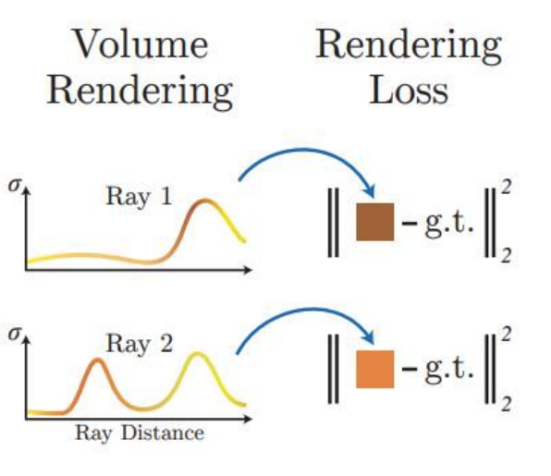
Method
Training network to reproduce all input views of the scene
Mildenhall et al, “NeRF: Representing Scenes as Neural Radiance Fields for View Synthesis”, ECCV 2020

Slide 14
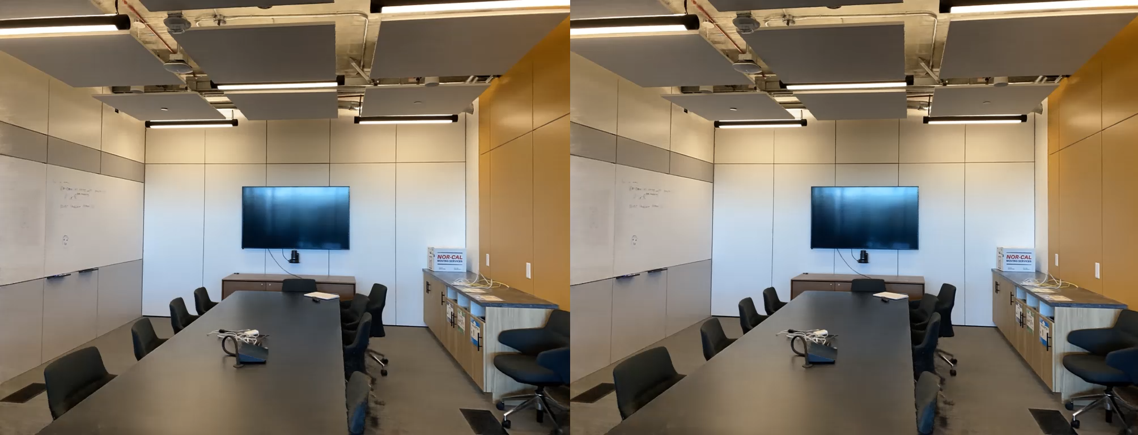
Results – View direction dependencies
Mildenhall et al, “NeRF: Representing Scenes as Neural Radiance Fields for View Synthesis”, ECCV 2020

Slide 15
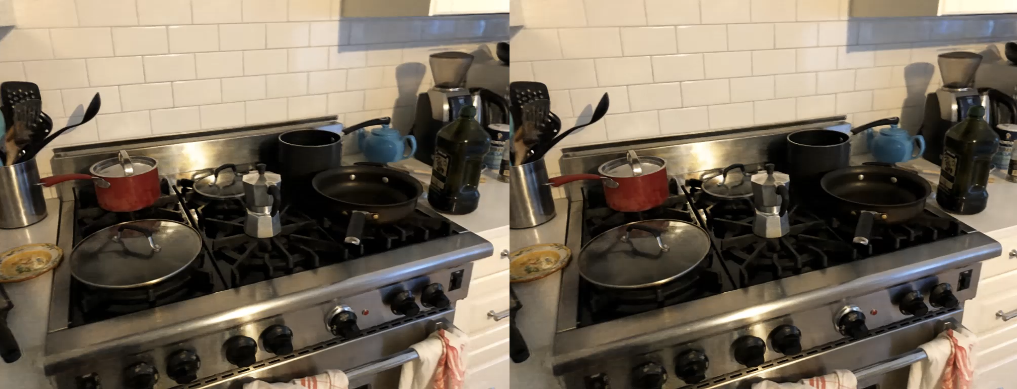
Results – View direction dependencies
Mildenhall et al, “NeRF: Representing Scenes as Neural Radiance Fields for View Synthesis”, ECCV 2020

Slide 16

Results – Depth map
Mildenhall et al, “NeRF: Representing Scenes as Neural Radiance Fields for View Synthesis”, ECCV 2020

Slide 17

Results – Depth map
Mildenhall et al, “NeRF: Representing Scenes as Neural Radiance Fields for View Synthesis”, ECCV 2020

Slide 18
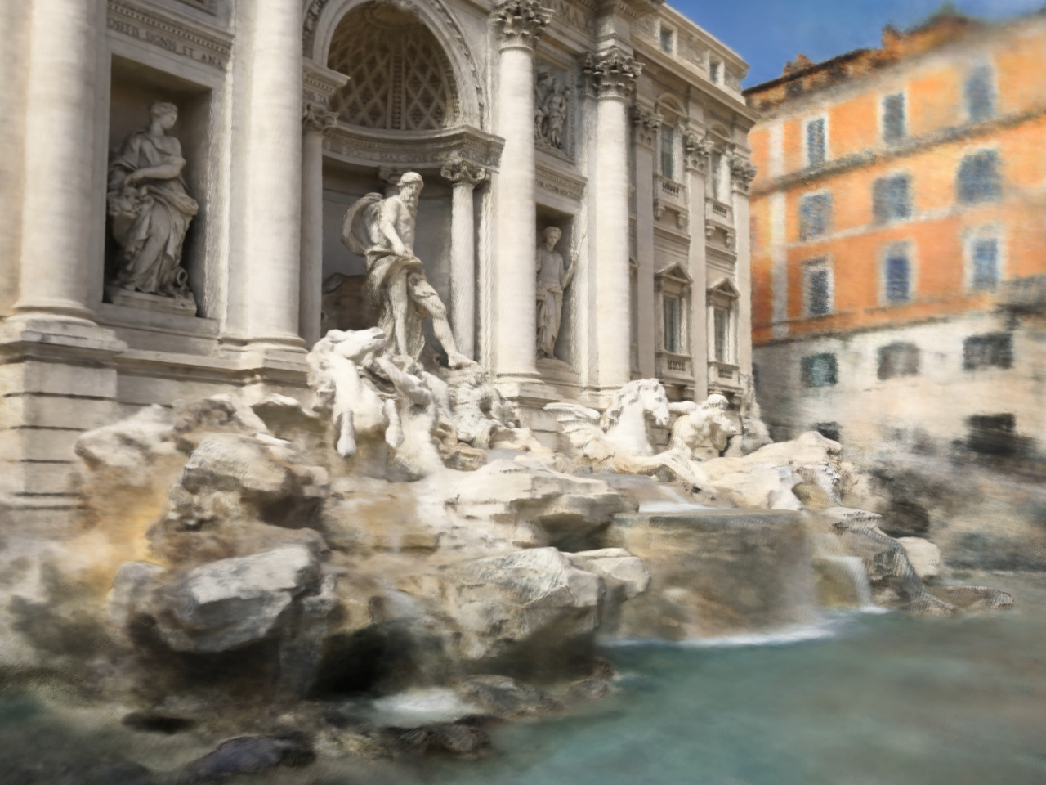
Future Works
In-the-wild setting
Appearance variations, occlusions, inaccurate camera poses
NeRF in the Wild: Neural Radiance Fields for Unconstrained Photo Collections

Slide 19
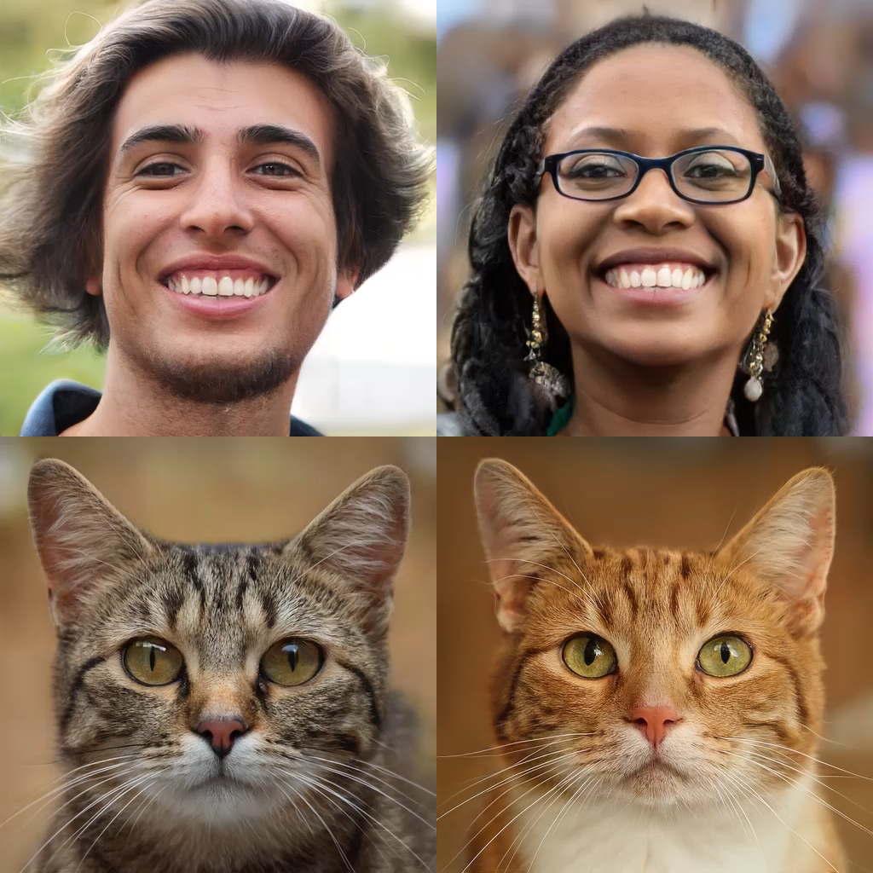
Future Works
NeRF + GAN
No need of Multiview images
Generate diverse images & scenes
Efficient Geometry-aware 3D Generative Adversarial Networks (EG3D)

Slide 20
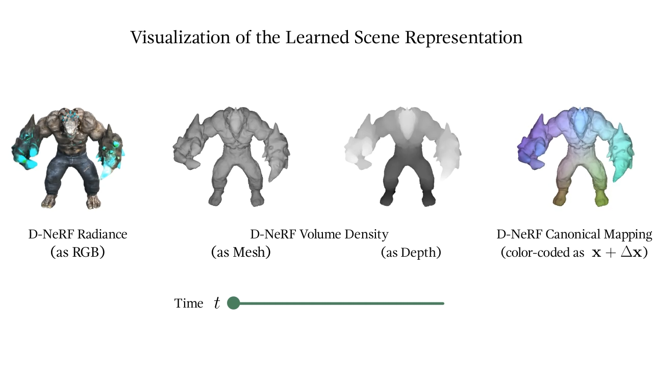
Future Works
Dynamic Scenes
D-NeRF: Neural Radiance Fields for Dynamic Scenes

Slide 21
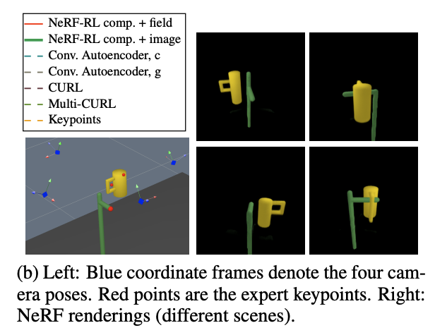
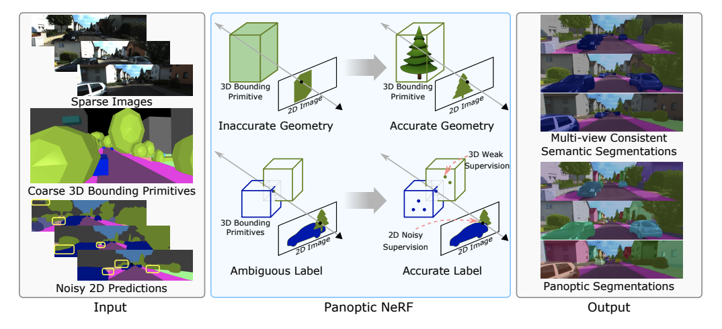
Future Works
3D understanding
Any task based on 2D images/videos that require 3D understanding(RL, )
Reinforcement Learning with Neural Radiance Fields / Panoptic NeRF: 3D-to-2D Label Transfer for Panoptic Urban Scene Segmentation

